Slide 1



Wine Quality Data Analysis By Using Machine Learning Model
By:-Karthik Reddy
Sainath Reddy
Preetha Ravi
Jothish Ps

Slide 2

Agenda
Introduction
Data Description
Model Description
Architectural Model
Application
References
This Photo by Unknown author is licensed und

Slide 3


Introduction
Industries are increasing their sales using product quality certification.
Nowadays, all over the world wine is a regularly used beverage and the industries are using the certification of product quality to increases their value in the market.
Previously, testing of product quality will be done at the end of the production, this is time taking process and it requires a lot of resources such as the need for various human experts for the assessment of product quality which makes this process very expensive

Slide 4
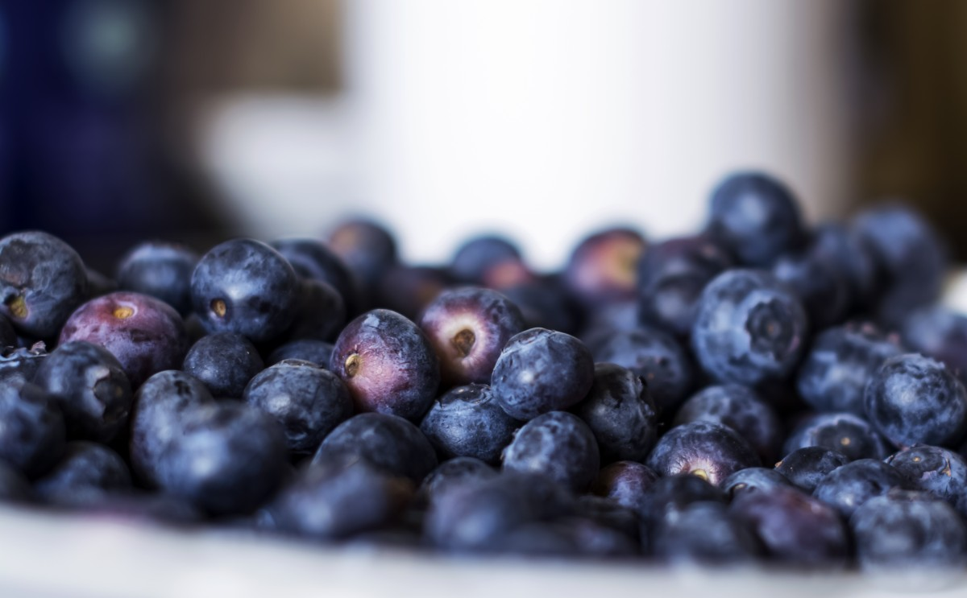
Data Description
The red wine have been used in this paper which is obtained from the UCI machine learning repository it contains a large collection of datasets that have been used for the machine learning community.
The dataset contains two excel files, related to red wine and white wine variants of the Portuguese “Vinho Verde” wine (Cortez et al., 2009). The red wine dataset contains 1599 instances and the white wine dataset contains 4898 instances.
Both datasets have 11 input variables (based on physicochemical tests): fixed acidity, volatile acidity, citric acid, residual sugar, chlorides, free sulfur dioxide, total sulfur dioxide, density, pH, sulfates, alcohol, and 1 output variable (based on sensory data): quality

Slide 5
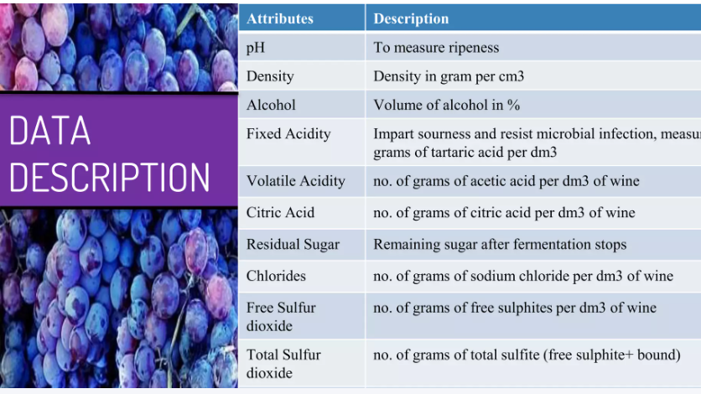

Slide 6
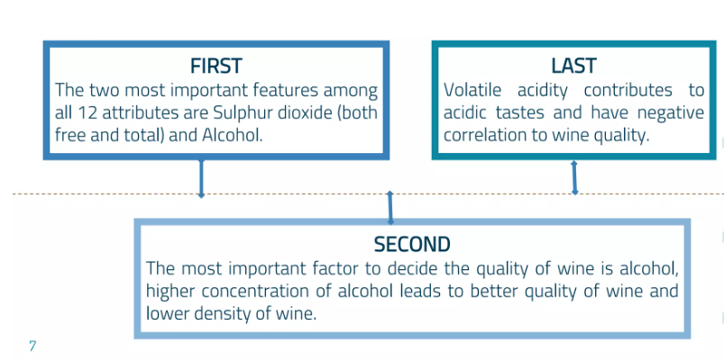
Conclusion Of Data Analysis

Slide 7
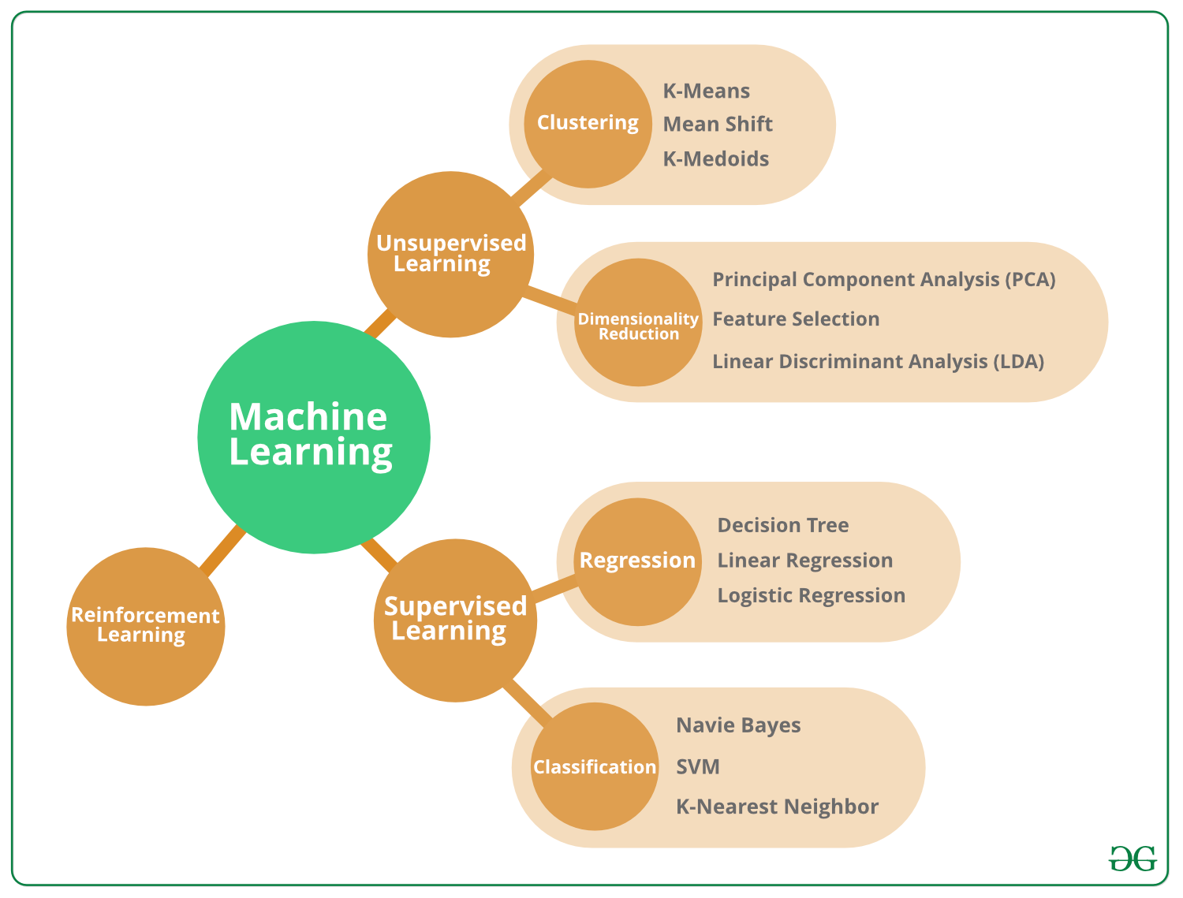
MODEL DESCRIPTION

Slide 8
RANDOM TREE FOREST
Random forest is a Supervised Machine Learning Algorithm that is used widely in Classification and Regression problems.
It builds decision trees on different samples and takes their majority vote for classification and average in case of regression.
Following are some of the features of random forest algorithm:
It is unexcelled in accuracy among current algorithms.
It runs efficiently on large data bases.
It can handle thousands of input variables without variable deletion.

Slide 9
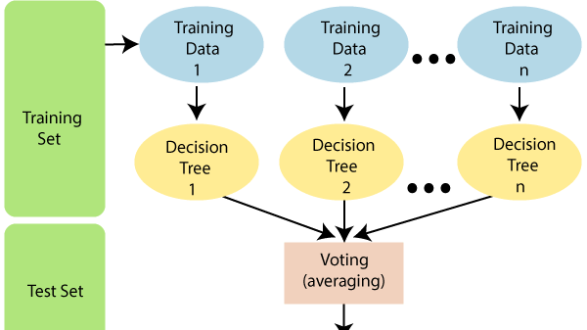

Slide 10
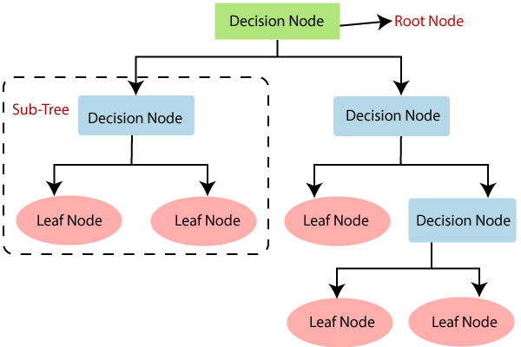
Decision Tree
A decision tree is a structure that includes a root node, branches, and leaf nodes. Each internal node denotes a test on an attribute, each branch denotes the outcome of a test, and each leaf node holds a class label. The topmost node in the tree is the root node.
The benefits of having a decision tree are as follows −
It does not require any domain knowledge.
It is easy to comprehend.
The learning and classification steps of a decision tree are simple and fast.

Slide 11
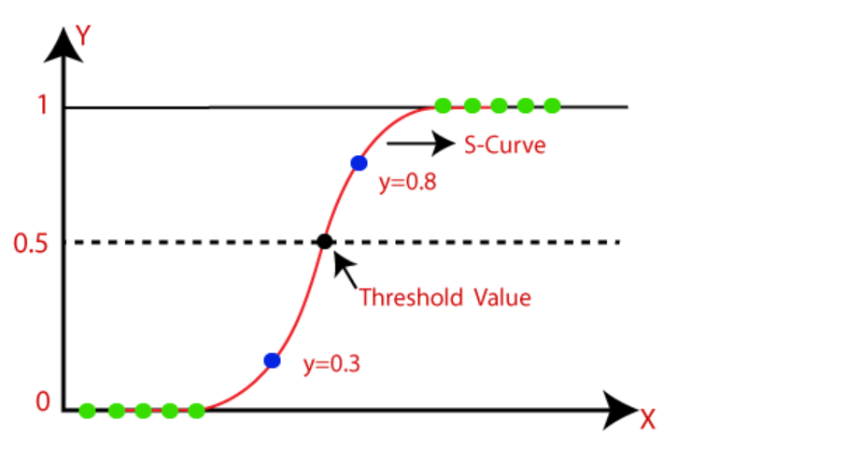
Logistic Regression
Logistic regression predicts the output of a categorical dependent variable. Therefore the outcome must be a categorical or discrete value. It can be either Yes or No, 0 or 1, true or False, etc. but instead of giving the exact value as 0 and 1, it gives the probabilistic values which lie between 0 and 1.
Logistic Regression is much similar to the Linear Regression except that how they are used. Linear Regression is used for solving Regression problems, whereas Logistic regression is used for solving the classification problems.
Assumptions for Logistic Regression:
The dependent variable must be categorical in nature.
The independent variable should not have multi-collinearity.

Slide 12

Conclusion
Target variable :Quality
Parameters associated : Alcohol, pH ,Acidity, Volatility.
The following accuracy of wine dataset:
Score | Model
79.93 | Decision tree Classifier
87.85 | Random Forest Classifier
89.099 | Extra Tree Classifier
30.78 | Logistic Regression

Slide 13
References
Dahal, K., Dahal, J., Banjade, H., Gaire, S., 2021. Prediction of Wine Quality Using Machine Learning Algorithms. Open J. Stat. 11, 278–289. https://doi.org/10.4236/ojs.2021.112015
J. Han, Micheline Kamber, Jian Pei, 2012. Data Mining: Concepts and Techniques 3rd Edition. DATA Min. 560
Rish, I., 2001. An Empirical Study of the Naïve Bayes Classifier. IJCAI 2001 Work Empir Methods Artif Intell 3.
Yu, T., Zhu, H., 2020. Hyper-Parameter Optimization: A Review of Algorithms and Applications. ArXiv200305689 Cs Stat.

Slide 14

Thank You
This Photo by Unknown author is licensed under CC BY-NC-ND.

